Slide 1


E-COMMERCE Project
ACCESS ANYTIME ANYWHERE
GUIDED BY:- DIVYA KUMAR
AAYUSHI JAIN
ATANU SEN
SANCHIT SINGH

Slide 2

AIM
Access Anytime Anywhere is a User Friendly Website. The main objective of system is which shows you how to collect information about hospitality and medical services.
The main objective of system can be enumerated as follows:
Patients are easily allocated to doctors.
Doctors can send message and prescription to patient.
Patient also send any query to doctor.
Staff Interaction.
The system also provide excellent security of data at every level of user-system interaction and also provide robust and reliable storage and backup facilities.

Slide 3

Background
FRONT END : Html, Css,java script, Bootstrap
SERVER SIDE SCRIPT : Java, jsp, servlet
DATABASE : Mysql
TOOLS REQUIRED- NetBeans, MySql query browser, jdk 8.0.

Slide 4
Work flow

Slide 5
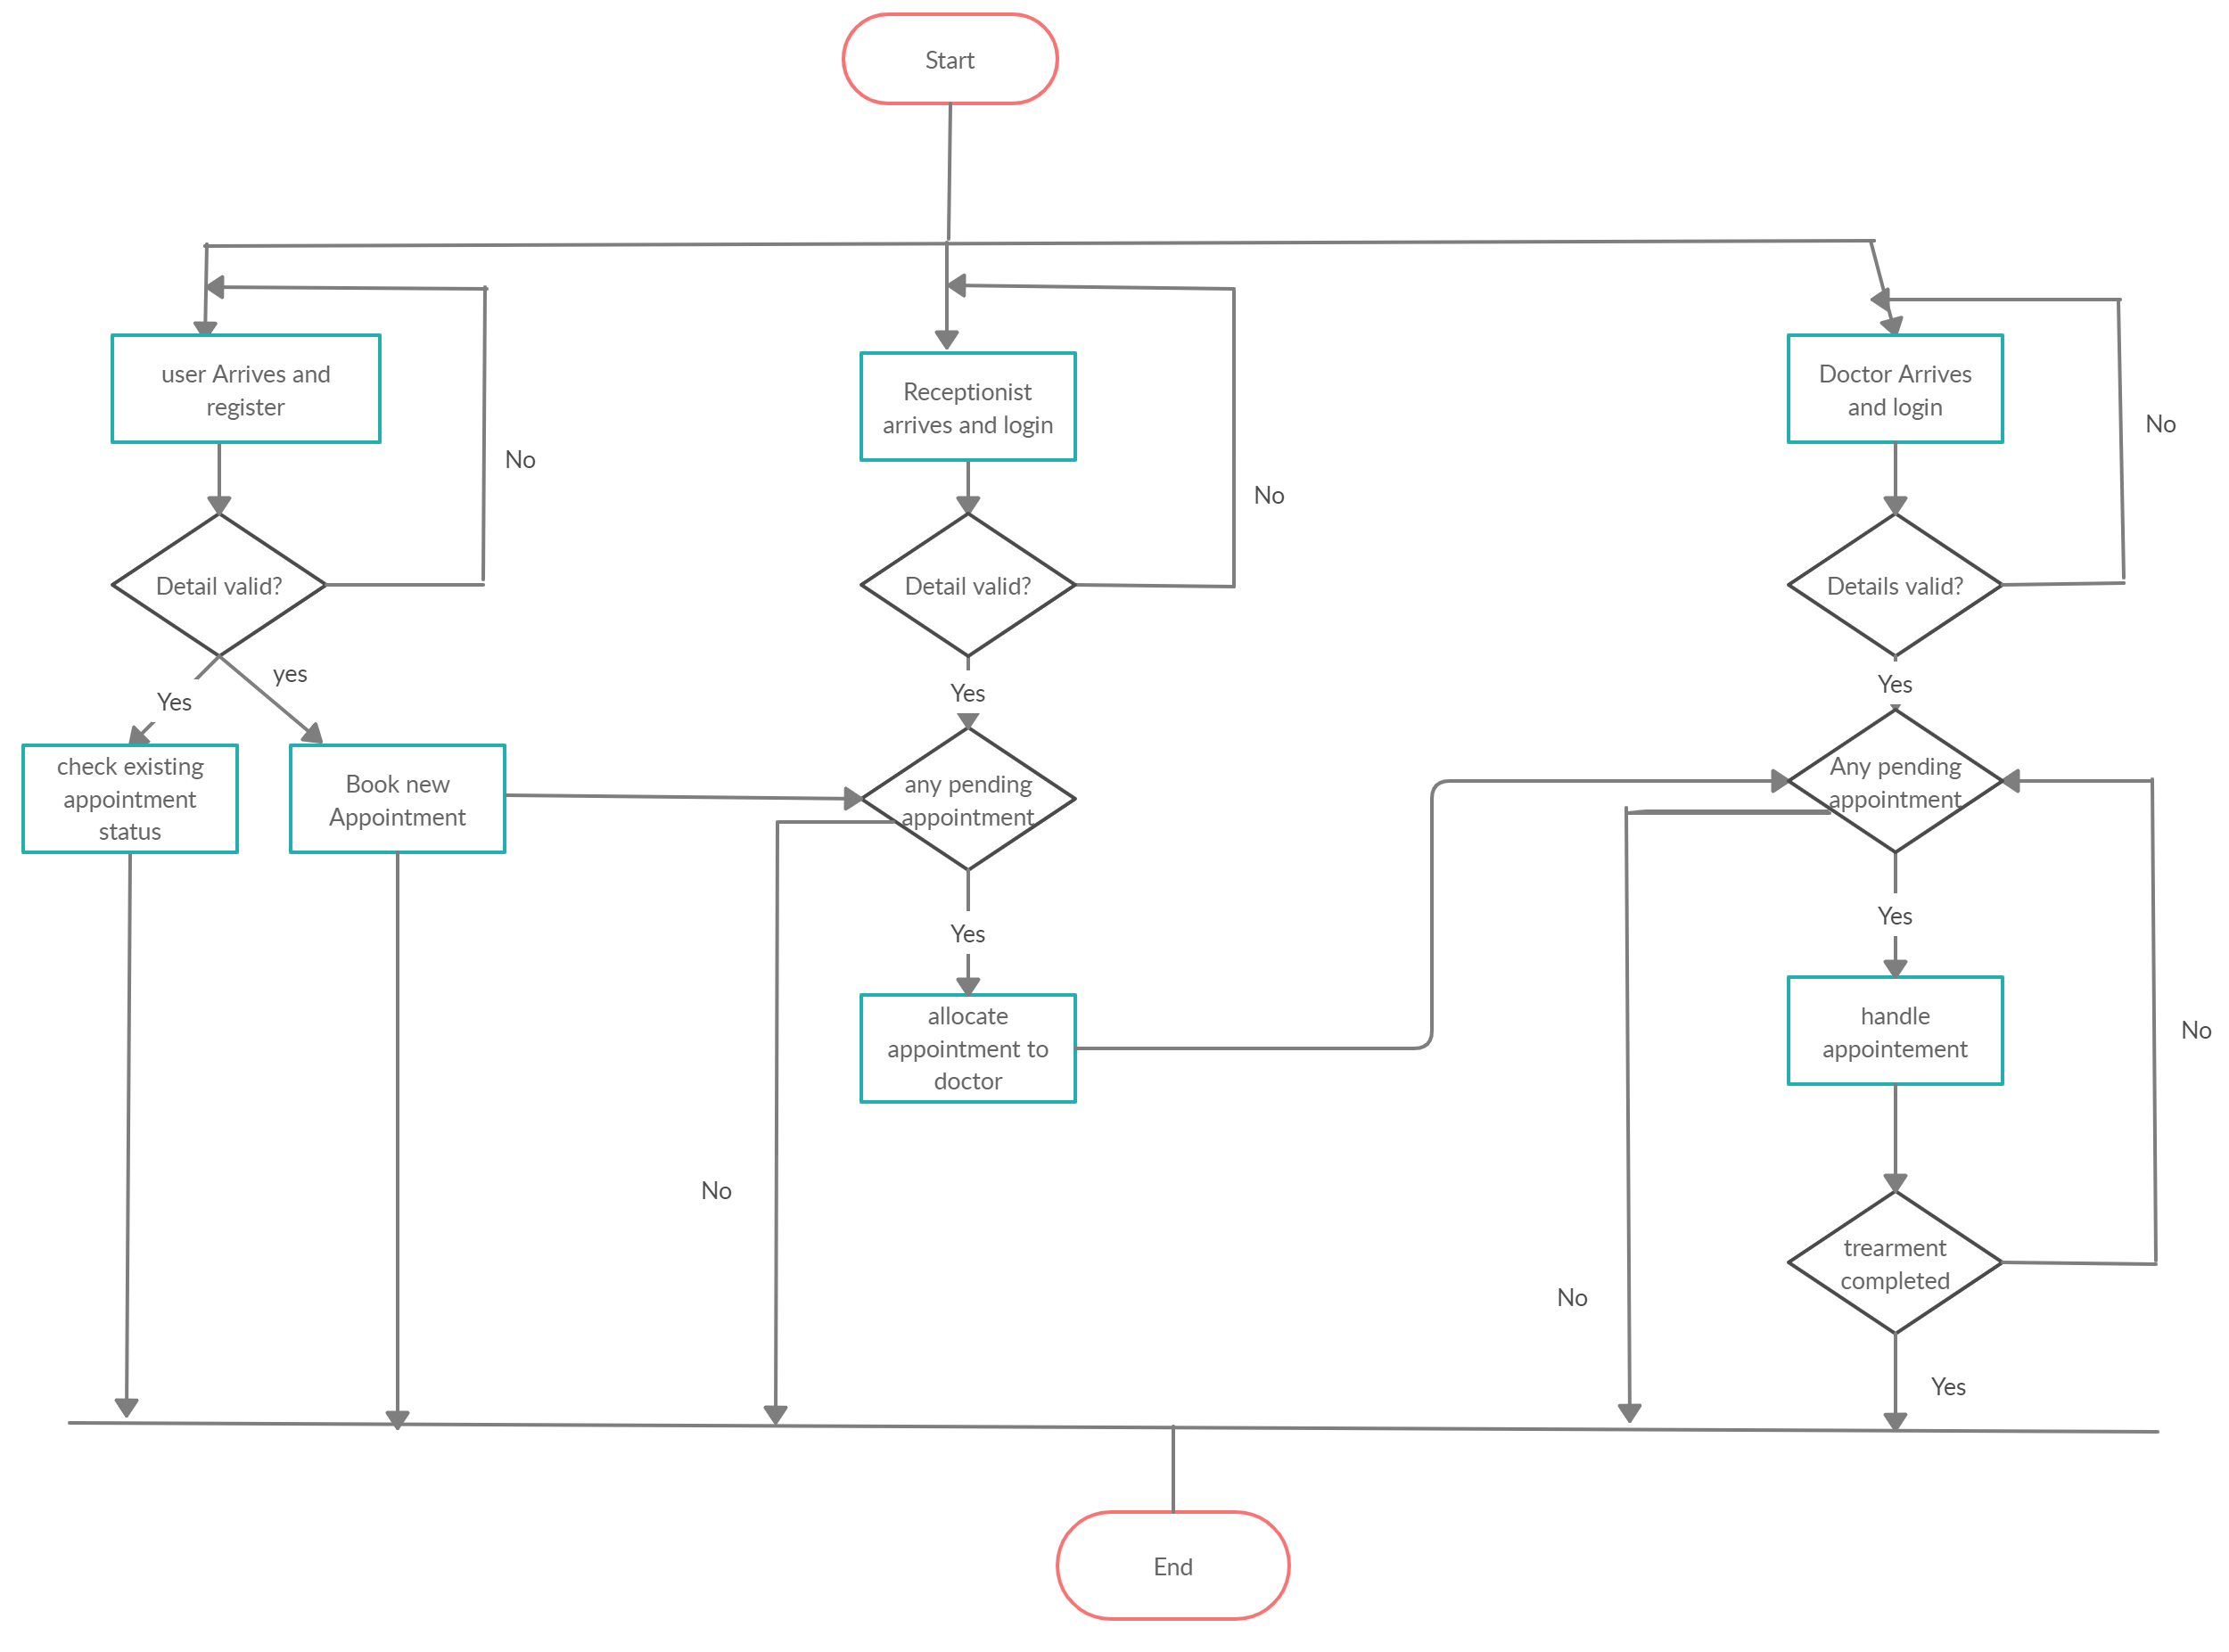

Slide 6
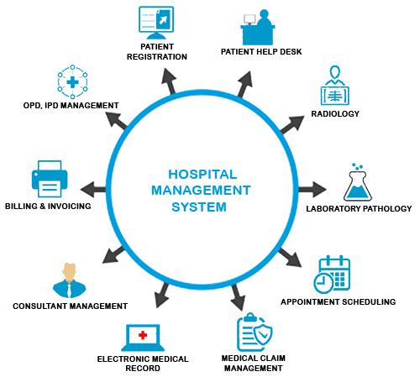
MODULES
Patient : This is the patient Details page. Patient can register to the website in this module. After registration patient can login to the system by entering login id and password.Patient can book appointment.
Appointment : This module is used to handle Daily Patient Appointment for the consultancy for a particular Time. In this module patient can take appointments through online. Receptionist can make offline appointment . Appointment module in hospital management arranges the schedule of doctors due to the patients’ application. It helps to organize the availability of medical specialists at any convenient.
Prescription module: This module deals with the activities related to storing the Prescription for a patient like Dosage, days.
Doctor module: Doctor can manage patient data, Write prescription to patient, Dashboard with appointment calendar,Single screen to get patient treatment details.

Slide 7
E-R Diagram

Slide 8
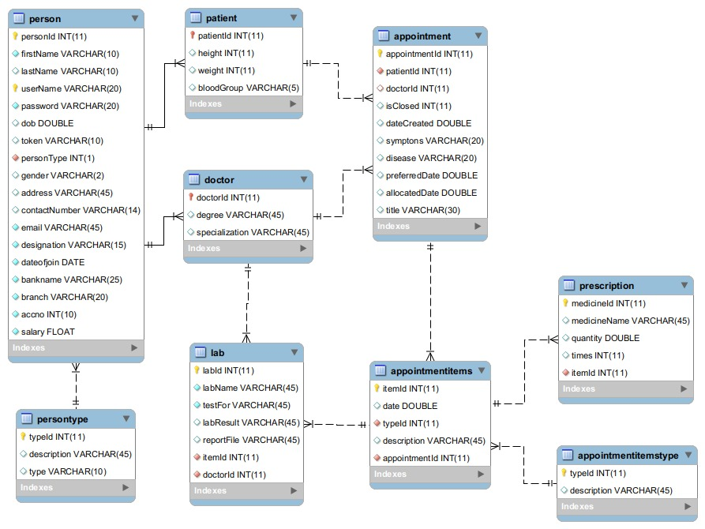

Slide 9
CONCLUSION
Taking into account all the mentioned details, we can make the conclusion that the hospital management system is the inevitable part of the lifecycle of the modern medical institution. It automates numerous daily operations and enables smooth interactions of the users. The system comprises of following features :-
1. Management of doctors.
2. Management of patients and patient Appointments.
3. Management of patient-doctor dialogue.
4. Management of patients previous visit and its information

Slide 10
Future Work
There are also few feature which can be integrated with this system to make it more flexible.
Below list show the future points to consider:
1. We can enhance this system by including pharmacy system for the stock details of medicines.
2. Billing of patients.
3. Mapped with Insurance Company for Claim processing.
4. Hangout for different doctors and patients at different locations.
5. Blood Bank Information Management.

Slide 11


